Slide 1
Agentic AI Hackathon: Building Intelligent Agents with IBM Granite and LangFlow
Project Name: AI Preventive Healthcare
Name of the team: WEIRD FISHES

Slide 2


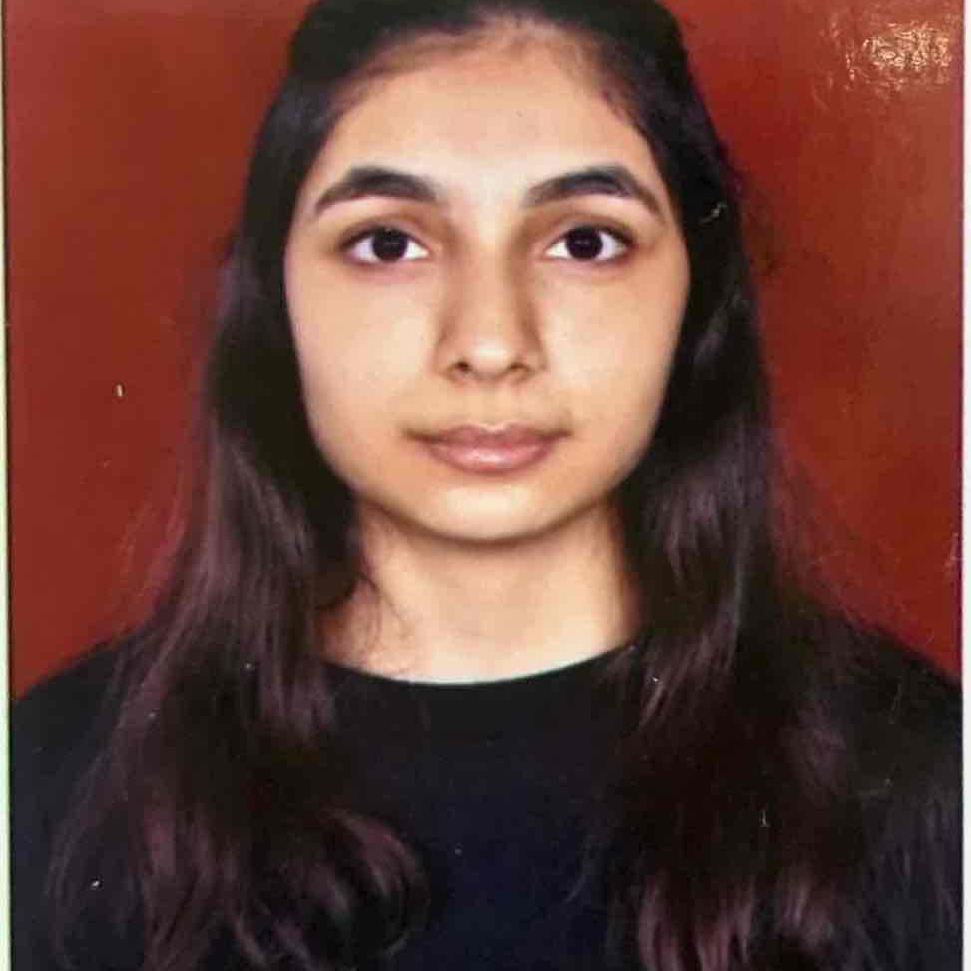
Details of Team members
TEAM MEMBER NAME | Passport Photo | Email ID | Phone number
Brahmansh Bora |  | brahmansh.bs23@bmsce.ac.in | +91 8433093895
Kartikeya Gupta |  | kartikeyagupta.bs23@bmsce.ac.in | +91 7903172319
Dimple Hirwani |  | dimplehirwani.bs23@bmsce.ac.in | +91 9569781007

Slide 3
Problem Statement
The Challenge: Reactive vs. Proactive Healthcare
•
Information Overload: Healthcare providers struggle to process fragmented patient data from various sources (wearables, logs, history).
•
Reactive Care: Interventions often occur only after symptoms manifest, leading to preventable complications.
•
Personalization Gaps: Generic health advice fails to account for individual lifestyle nuances and real-time habits.
•
Lack of Integration: Disconnected systems prevent a holistic view of patient health risk.

Slide 4
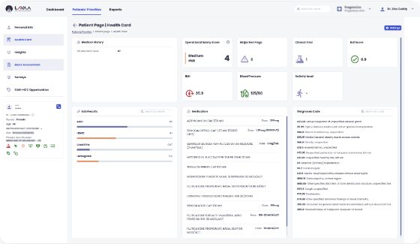
Proposed Solution
We are using an Agentic AI system: HealthGuard AI.
A multi-agent architecture that orchestrates:
•
Lifestyle Analysis: Parsing unstructured inputs.
•
Risk Assessment: Comparing data against medical baselines.
•
Advisory Services: Generating personalized health plans.

Slide 5
Need of Project
•
Rising Chronic Diseases: Conditions like Diabetes and Hypertension are surging globally.
•
Cost Efficiency: Preventive care is significantly cheaper than emergency treatments.
•
Data Utilization: Leveraging the massive amount of unused health data generated by patients daily.
•
Accessibility: Providing expert-level risk assessment to underserved populations via AI.

Slide 6

End User of Project
•
Patients / Individuals: People looking to proactively manage their health and receive daily guidance.
•
Healthcare Providers: Doctors requiring a pre-screening tool to identify high-risk patients efficiently.
•
Insurance Companies: Organizations seeking to reduce payouts by encouraging preventive health measures.

Slide 7
Technology Used
•
Langflow Platform: For visual orchestration of the multi-agent system.
•
Langflow Components: Chat Input, Chat Output, Custom Agents, Astra DB Tool.
•
IBM Granite Model: ibm-granite-3-8b-instruct for high-performance reasoning.
•
Database: DataStax Astra DB (Cassandra) for vector search and retrieval.
•
AI Engine: IBM Watsonx.ai for foundation model access.

Slide 8
Novelty and Uniqueness
•
Agentic Architecture: Unlike simple chatbots, our agents have distinct roles and tools, collaborating to solve complex problems.
•
Contextual Awareness: Uses vector search to recall past health history, providing continuity in care.
•
Granite-Guarded Outputs: Ensures medical advice remains within safe, bias-free boundaries.
•
Real-time Orchestration: Dynamic adjustment of risk scores based on live conversation data.

Slide 9
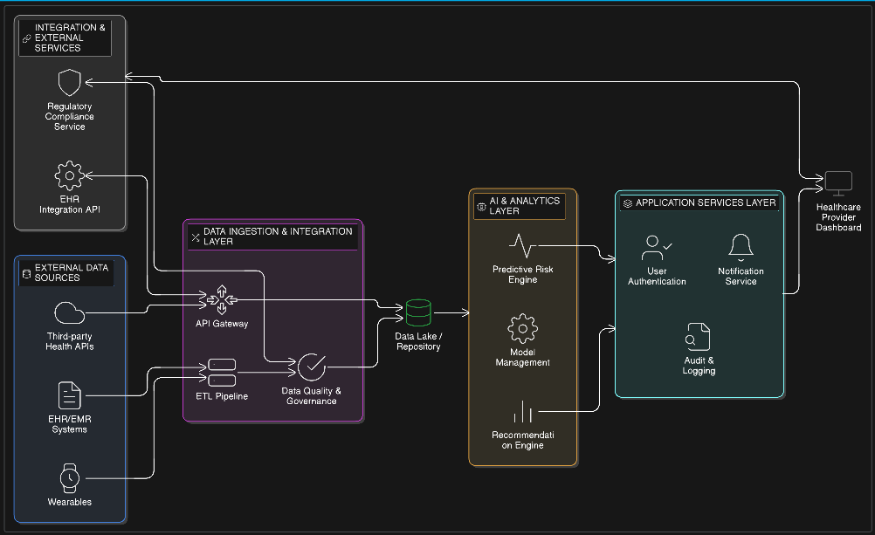
Technical Flow Diagram - Architecture Blueprint
High-level architecture showing User Input -> Langflow Agents -> IBM Watsonx/Astra DB -> Response

Slide 10
Langflow Component Used
•
Chat Input: Captures natural language queries from the patient.
•
IBM watsonx AI Agent: The core reasoning unit configured with the Granite model.
•
Astra DB Tool: Allows agents to query the vector database for similar medical profiles.
•
Prompt Component: Structures the system instructions for the Lifestyle and Risk agents.
•
Chat Output: Delivers the final formulated health advice to the user.

Slide 11
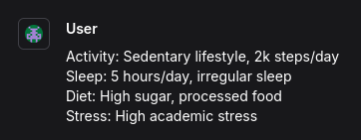
Input Screenshot 1

Slide 12
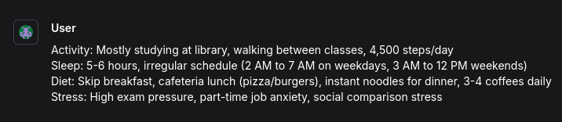
Input Screenshot 2

Slide 13
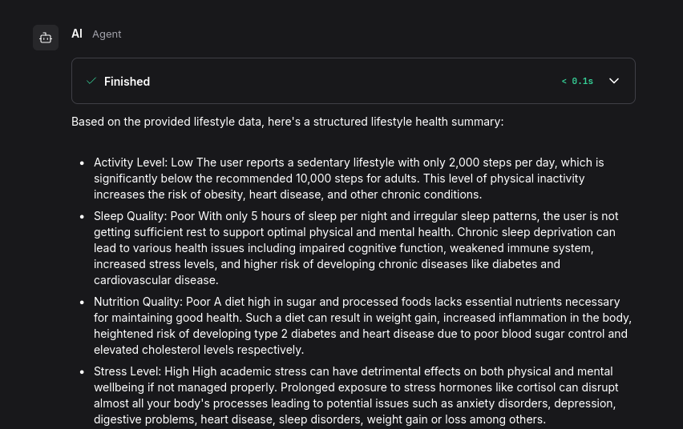
Output Screenshot 1

Slide 14
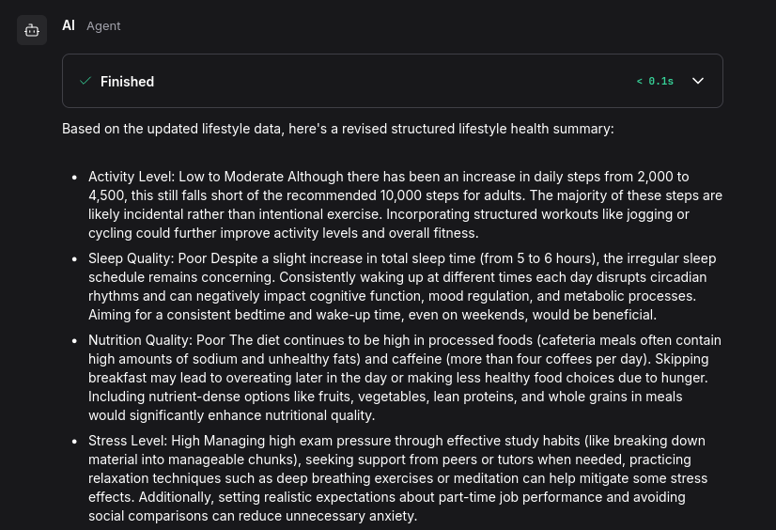
Output Screenshot 2

Slide 15

Future Scope
•
Wearable Integration: Direct API connection to Fitbit/Apple Health for real-time vitals monitoring.
•
EHR Compatibility: Seamless sync with hospital Electronic Health Records (FHIR standards).
•
Voice Interface: Adding speech-to-text capabilities for elderly patients.
•
Multilingual Support: Expanding the model to support regional languages for wider accessibility.

Slide 16

Git Hub Link
Please test and access our working project here:
https://github.com/Kartikeya-G121/AI-Preventive-Healthcare-/
(Repository contains app.py, problem_statement.pdf, and presentation.pptx)

Slide 17
References
•
Langflow Documentation - https://docs.langflow.org
•
IBM Watsonx.ai - https://www.ibm.com/products/watsonx-ai
•
DataStax Astra DB - https://astra.datastax.com
•
Preventive Health Guidelines (CDC) - https://www.cdc.gov/chronicdisease

Slide 18
Thank You!
Thank you for your time and interest.
Team WEIRD FISHES

